Slide 1
Sports Medicine.
Presentation.

Slide 2


Slide 3
Introduction.
Emphasizes on physical fitness and prevention of injuries.
Promotes health in a scientific assessment.
Involves aspects such as treatments of injuries, prevention of injuries and nutrition.
Trainers, surgeons, physical therapists, and special physicians are involved.
Notes:
Sports Medicine is an interdisciplinary branch of medicine and mainly focuses on physical fitness among sports people and the aged. Through Sports medicine, these groups of people are guaranteed prevention, diagnosis, and treatment of injuries. The primary professionals in sports medicine include; trainers, surgeons, physical therapists and special physicians (Best 45).

Slide 4
History.
Traced back from the old medical specialty, Chinese Writing, and early Hindu.
Increased Research in Olympics in 1866.
Contribution of the International Hygiene Exhibition in 1911.
Establishment of the first Sports Medicine Department in 1950
Establishment of Orthopedic Traumatological Sports Medicine in 2000.
Notes:
The history of sports medicine can be traced back in the 17th century during the old medical specialty, Chinese Writing, and early Hindu traditions. Developments were extended to the 19th century during the Olympic Games where research in Sports medicine was sought to improve the physical aspects of athletes. The first Sports Medicine Department was established in 1950 followed by the establishment of the Orthopedic Traumatological Sports Medicine in 2000, and these have spearheaded the current face of Sports Medicine (Best 48).

Slide 5
Organizational Structure.
Most Sports' medicine centers are corporate entities.
Managers lead the entities.
Establishment of policies, rules, and regulations by the managers.
Involvement of professional health staff.
Notes:
Majority of sports Medicine firms are corporate entities. In most cases, these firms have managers of directors who control their daily operations. The managers set policies, rules, and regulations to control their daily activities. Also, the health staff or employees are involved in decision making to ensure that the clients are offered effective services (Carlos 48).

Slide 6
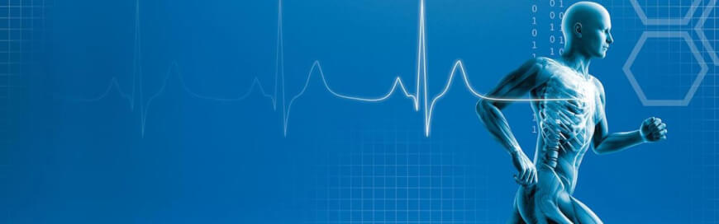
Sports Medicine and the Elderly.
Revolutionization of care delivery.
Focus on the elderly athletes.
Improved breathing capacity, heart rate, bone strength, flexibility, and muscular strength.
Notes:
Sports Medicine has shaped the healthcare delivery system through specialization. In this case, the elderly athletes have a very core avenue through which they can receive care. Sports medicine creates a room for training, facilitates access of supplements, educates the elderly on physical fitness and creates time for the elderly to recover. These programs lead to the improvement of breathing capacity, heart rate, bone strength, flexibility, and muscular strength among the elderly (Carlos 48).

Slide 7
Service Delivery.
Focus on a comprehensive diagnosis and treatment plan.
Involvement of a medical doctor and an athlete.
Creation of treatment schedules.
Critical focus on nutrition.
Notes:
The delivery of services in Sports medicine is dependent on the need of the patient. After assessing the patient's needs, effective treatment is sought. Diagnosis plays a very core part of the treatment plan. In most cases, there is a combination of physical therapy, athletic training, nutrition and physical services (Daniel 89). The physician always creates a schedule between himself and herself with the patient as a follow up for the recovery process. In most cases, service delivery is based on diagnosis and treatment options, proposal of a treatment plan, rehabilitation, monitoring the recovery process and provision of medication.

Slide 8
Employment Opportunities
Athletic Trainer.
Physical therapist.
Notes:
Athletic trainers in Sports medicine are well trained medical professionals and not normal personal trainers or exercise instructors. Athletic trainers are individuals with skills in preventing and treating sports injuries and always require state licensing. The athletic trainers work with coaches, athletes, physical therapists, and doctors. Athletic trainers require college degree and state licensing (Daniel 32). Physical therapists are also part of the necessary professionals in Sports medicine. These are professionals trained in using exercises, manual manipulation, and specialized equipment to improve an athlete's physical abilities. In most cases, they deal with the aged population. Physical therapists require a master's Degree and state licensing.

Slide 9
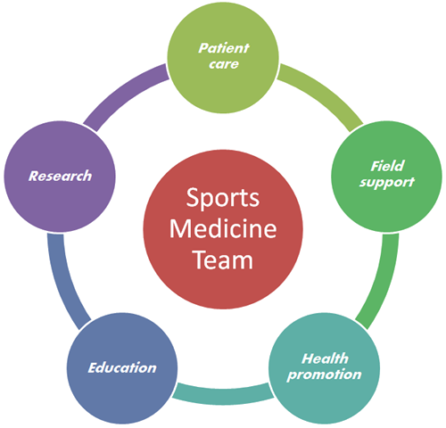
Employment Opportunities Continued………..
Nutritionist.
Medical doctor.
Notes:
Nutritionists are very important in Sports Medicine, and they are vital in advising individuals on the best diet to consume. They nutritionists scrutinize the meal plans and the menus of the athletes and the elderly. The nutritionists should have an undergraduate certification from the American Dietetics Association (Sfandiari 70). Medical doctors also play a very core role in Sports Medicine. The doctors require at least four years' training in a medical school. The doctors are core in diagnosing diseases and injuries, provision of physical therapy, medicine, hospitalization, and surgery.

Slide 10
Budget and Funding.
Spending Ceiling/Increment Budget.
Spending model budget.
Zero Based Budget.
Grant organization funding.
Private funding.
Government funding.
Notes:
Increment budget is provided as a boost for the spending in the previous year in Sports medicine firms, the spending reduction model is sought to preserve institution funds while the zero-based budget is sought due to the frequent organizational alternations. Sports Medicine is usually funded by nongovernmental organizations, grant organizations, private f1rms as well as the government (Kodali et al. 158).

Slide 11
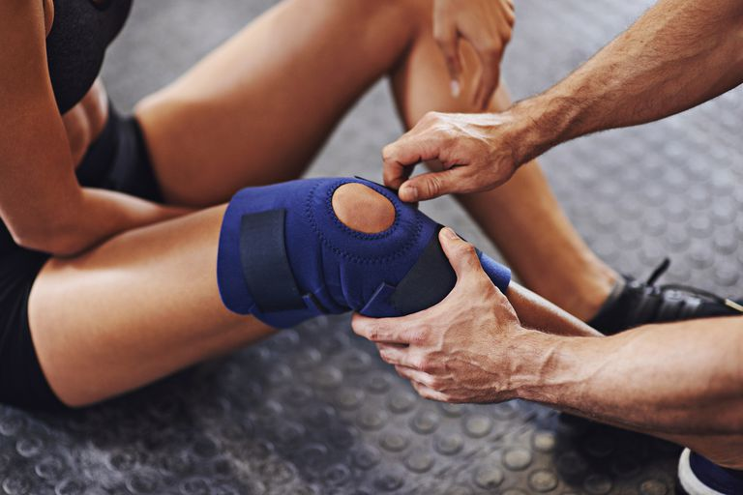
Problem Areas in Sports Medicine.
Physical Injuries.
Psychological problems.
Notes:
Most sportsmen and women face physical injuries and such, and their high number might overwhelm the capability of professionals in Sports Medicine. Also, some of these injuries are very difficult to treat. Some athletes also struggle in the desire to balance between the sport and work or school and this is also a challenging area in Sports medicine (Kodali, Islam & Andrish 156).

Slide 12
Conclusion.
Sports Medicine is a vital health delivery system.
Focuses on older adults and athletes.
Increase training and funding of Sports medicine.
Focus on both Physical and Psychological health.
Notes:
It is indisputable that Sports Medicine is a core area in health aspects and as such, critical focus should be extended to the specialty to achieve the goals of the professionals, the athletes and the elderly (Robert 7). More professionals should be trained and educated on the skills of Sports Medicine, and also, NGO's, the Government and private firms should increase funding the area so to benefit all the stakeholders.

Slide 13
Works Cited.
Best, J. P. (2005). 20 common problems in sports medicine. British Journal of Sports Medicine, 39(1), 120 – 142
Carlos, Sharp. "Sports and Exercise Science, Essays in the History of Sports Medicine." British Journal of Sports Medicine (1994): 64.
Daniel, Romanelli. "Sports Medicine Media Guide." The American Orthopaedic Society for Sports Medicine (2011): 1-33.
Sfandiari, A., Broshek, D. K., & Freeman, J. R. Psychiatric and Neuropsychological Issues in Sports Medicine. Clinics in Sports Medicine, 30(3), 76 – 88. (2011).
Kodali, P., Islam, A., & Andrish, J. Anterior Knee Pain in the Young Athlete. Sports Medicine and Arthroscopy Review, 19(1), 156 – 160.(2011).
Robert, Bradley. "A Comparison of Athletic Training Program Financial Resources." The Sport Journal (2010): 7-9.

